Slide 1
Irrigation Monitoring with Control System using IoT
Guru Ghasidas Vishwavidyalaya
School of Studies in Engineering and Technology
Project Guide : Anand Prakash Rawal By: Balkaran Kumar & Vivek Bharati

Slide 2
Table of Contents
1.Why this Project ? 2.What is IoT ? 3.Hardware and Software Requirements 4.Working of the Project 5.Future Scope 6.Advantages 7.Disadvantages 8.Progress Status
9. Architecture
10. References

Slide 3
1.Why this Project ?
Farmers usually work on large portions of land to grow different types of crops. It is usually not always possible for one person to be able to keep track of the entire farmland all the time.
Sometimes it may happen that a given patch of land receives more water leading to water-logging, or it might receive far less or no water at all leading to dry soil.
In either of the cases, the crops can get damaged and farmer may suffer losses.

Slide 4
2. What is IoT ?
The Internet of Things (IoT), consists of all the web-enabled devices that collect, send and act on data they acquire from their surrounding environments using embedded sensors, processors and communication hardware.

Slide 5
3. Hardware and Software Requirement
•Arduino Uno R3 •ESP8266 Wifi Module •Water Sensor Module •Relay Driver IC •Voltage Regulator IC •Breadboard • LCD’s
•Resistors •Cables & Connectors •LED’s •Transformer/Adapter •Push Button

Slide 6
Software
• Arduino Compiler • Programming Language: C++

Slide 7
4. Working of the Project
• We connect our system to the internet using a Wi-Fi module. • We use an Arduino Uno board to send the control signals and to connect to our desired App using Remote XY. • On the App, two things are displayed: a) Motor status b) Moisture level • The circuit keeps checking the moisture content of the soil by means of a moisture sensor, and updates the “Moisture level "on the App. The user can then check the current moisture level from a remote location and control the water supply. • For this, the user only has to toggle the “Motor status” from ‘ON-OFF’ or ‘OFF-ON’; and the “water pump” will be ‘turned ON’ or ‘turned OFF’ accordingly. • Thus the ‘soil-moisture’ gets monitored and the ‘water supply’ can be controlled just by the toggling the “Motor status”.
So the user doesn’t have to worry about his crops or plants getting damaged due to ‘water-logging’ or ‘drought’.

Slide 8
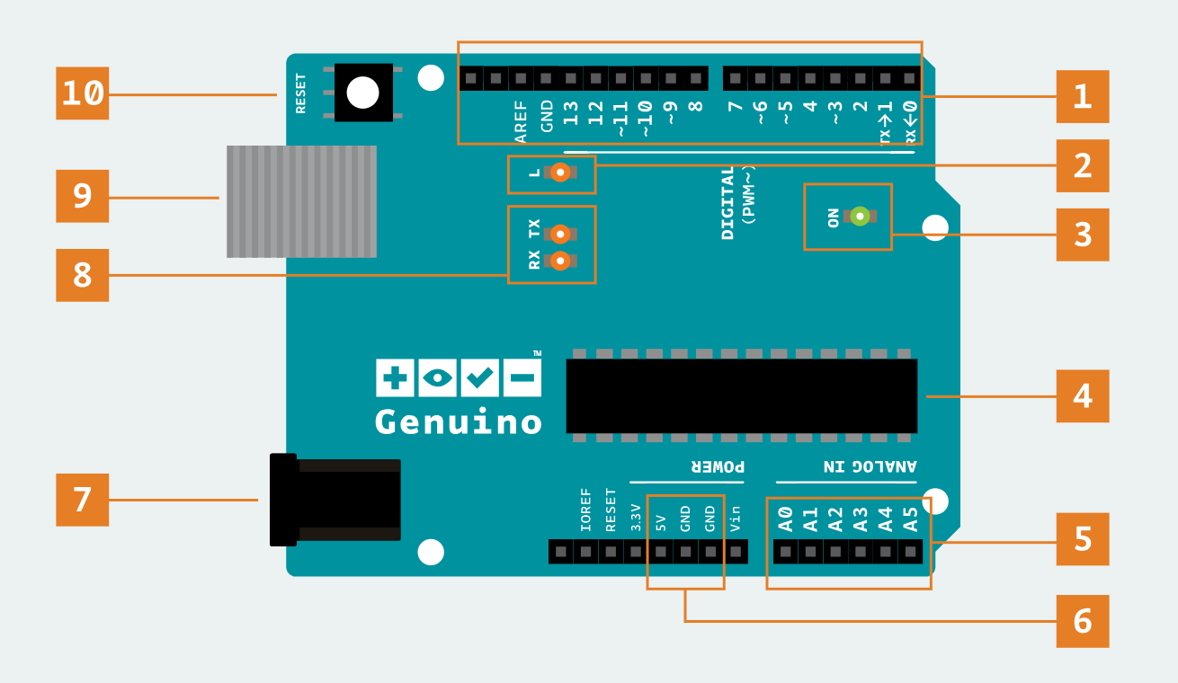
Arduino UNO Board

Slide 9
Arduino Compiler
There are Two Types of C++ Functions
Void setup() – the setup function runs once when you press reset or power the board
Void loop() - the loop function runs over and over again forever

Slide 10
5. Future Scope
Instead of just using the Moisture Sensor , we can use other sensors which senses the Soil Nutrients ( Nutrients Sensor ) which are necessary for a plant to grow optimally.

Slide 11
6. Advantages
• Easy Monitoring of Crops • Resource Saving • Increased Productivity • Crop Analysis • Future Planning

Slide 12
7. Disadvantage
• High initial Investment • Low Accuracy for Non Uniform Soil Granules

Slide 13
8. Progress Status

Slide 14
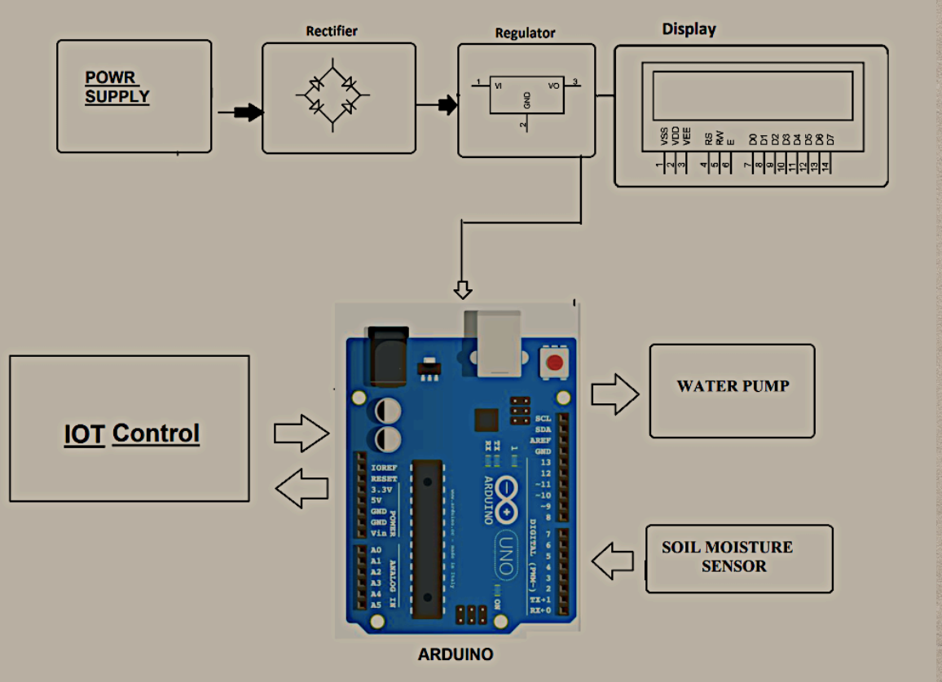
10. Architecture

Slide 15
9. References
REVIEW PAPER BASED ON AUTOMATIC IRRIGATION SYSTEM BASED ON RF MODULE, by Ms. Deweshvree Rane PG Scholar - VLSI, Sevagram, Wardha, India. Published by IJAICT Volume 1, Issue 9, January 2015,
SENSOR BASED AUTOMATED IRRIGATION SYSTEM WITH IoT: A TECHNICAL REVIEW by Karan Kanasura, Vishal Zaveri, Babu Madhav Institute of Technology, Uka Tasadia University, Bardoli, Gujarat, India : ISSN:0975-9646

